Slide 1
Twitter and Business

Slide 2
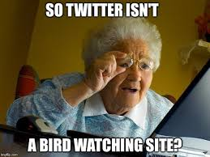
What is Twitter?
Twitter is a social media network that allows the user to send a message, or post, to all of his followers. This post must be limited to a max of 140 characters and is used by many. Tons of celebrities and other important people and businesses like Apple.

Slide 3
History of Twitter
Twitter was founded by Evan Williams, Noah Glass, Jack Dorsey, and Biz Stone on March 21, 2006. Twitter was launched in July of 2006 and rapidly grew more popular worldwide with the growth of social media. This service now has over 100 million users and as of 2012 has over 340 million tweets a day.

Slide 4
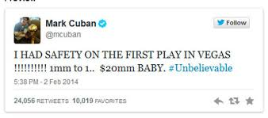
Uses in Business
Twitter is not only used by celebrities but is also used by businesses and businessmen. Companies such as Apple, Arbys, Delta, CocaCola, CNN, Starbucks, and some businessmen like Mark Cuban and Robert Herjavec.
Businesses can use Twitter to improve by branding with their profile picture, using Twitter to market to potential customers, get feedback from their tweets about their new product, and giving links to other online things such as their website, their Instagram, etc.

Slide 5
Advantages and Disadvantages
Advantages: Twitter gives opportunities for businesses to outreach to their customers. By tweeting a business can not only grab the attention of customers but also potential customers. Furthermore, a business can get feedback from their tweets and see if people like or dislike what they are saying.
Disadvantages: Although there are multiple advantages for using Twitter for business there are also disadvantages for instance if a business is solely dependent on technology they could get hacked and get their information stolen. Furthermore, if there is a power outage, work could not get done and you would lose work time, and in severe cases there could be loss of data.

Slide 6
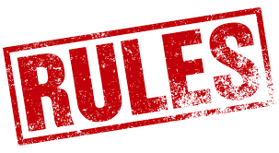
Rules Businesses Should Follow
Don’t Spam
Stick to 140 characters (less if possible)
Give credit for retweets
Be authentic
Use hashtags properly
Tweet positive things.

Slide 7
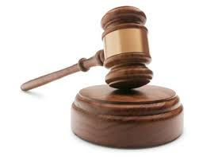
If the Rules Are Broken
If the rules are broken by businesses it could lead to consequences. If a business keeps tweeting long and repetitive tweets consumers will get bored, then will unfollow, and eventually stop buying your product. Furthermore, if a business does not know how to use hashtags their tweets could end up on other searches making consumers dislike their product and company more because it wasted their time. Finally, being positive is the key because if a business is continually negative eventually some consumers will find disinterest in them.

