Slide 1
Financial Management
Intro to Business and Technology

Slide 2
Unit 7 – Financial management
Standard FIN-IBT-8: Understand, interpret, and use accounting principles to make financial decisions.
Essential Question: How can a business owner use financial management to help guide their business?
Bell Ringer: Turn in Unit 6 Bell Ringers
Today’s Assignment: Accounting Vocab Preview
GRADES FOR UNIT 6 – MONEY MANAGEMENT WILL BE ENTERED THIS WEEK! Submit ALL missing assignments – anything turned in after school Friday will NOT be accepted!

Slide 3
Unit 7 – Financial management
Standard FIN-IBT-8: Understand, interpret, and use accounting principles to make financial decisions.
Essential Question: How can a business owner use financial management to help guide their business?
Bell Ringer: Which of the following would NOT be a step in the Accounting Cycle?
Collect and verify documents
Journalize each transaction
Create financial documents
Prepare financial statements
Today’s Assignment: The Accounting Equation

Slide 4
Unit 7 – Financial management
Standard FIN-IBT-8: Understand, interpret, and use accounting principles to make financial decisions.
Essential Question: How can a business owner use financial management to help guide their business?
Bell Ringer: What is the Accounting Equation?
Today’s Assignment: Accounting Transactions

Slide 5
Unit 7 – Financial management
Standard FIN-IBT-8: Understand, interpret, and use accounting principles to make financial decisions.
Essential Question: How can a business owner use financial management to help guide their business?
Bell Ringer: What is all income that a business receives called?
Today’s Assignment: Accounting Transactions

Slide 6
Unit 7 – Financial management
Standard FIN-IBT-8: Understand, interpret, and use accounting principles to make financial decisions.
Essential Question: How can a business owner use financial management to help guide their business?
Bell Ringer: What are the four main types of financial statements?
Today’s Assignment: Your choice: Teen’s Guide to Financial Statements or Analyzing Financial Statements

Slide 7
Unit 7 – Financial management
Standard FIN-IBT-8: Understand, interpret, and use accounting principles to make financial decisions.
Essential Question: How can a business owner use financial management to help guide their business?
Bell Ringer: How does a company determine debt to equity ratio?
Today’s Assignment: Introduction to Excel 2010

Slide 8
Unit 7 – Financial management
Standard FIN-IBT-8: Understand, interpret, and use accounting principles to make financial decisions.
Essential Question: How can a business owner use financial management to help guide their business?
Bell Ringer: In Excel, what is used to enter, calculate, manipulate, and analyze data?
Today’s Assignment: The Basketball Problem

Slide 9
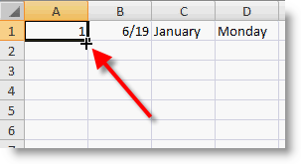
Unit 7 – Financial management
Standard FIN-IBT-8: Understand, interpret, and use accounting principles to make financial decisions.
Essential Question: How can a business owner use financial management to help guide their business?
Bell Ringer: In Excel, what is the small black square in the lower corner of the heavy border of an active cell that repeats a cell’s value in adjacent cells?
Today’s Assignment: Excel Practice 1

Slide 10
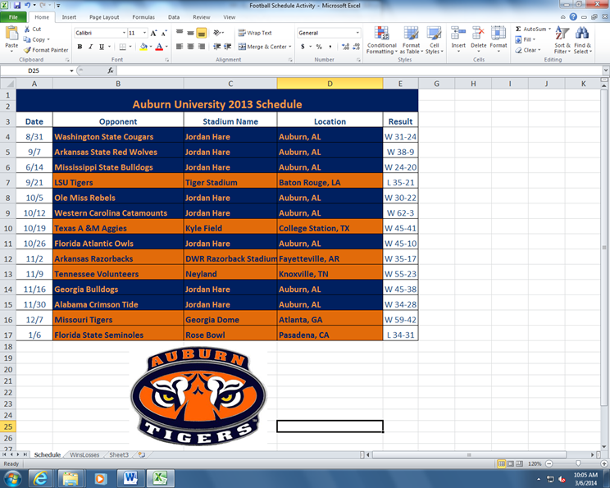
Unit 7 – Financial management
Standard FIN-IBT-8: Understand, interpret, and use accounting principles to make financial decisions.
Essential Question: How can a business owner use financial management to help guide their business?
Bell Ringer: What symbol appears in place of text when a column is too narrow to accommodate the text?
Today’s Assignment: Excel Football Schedule Activity – Part 1

Slide 11
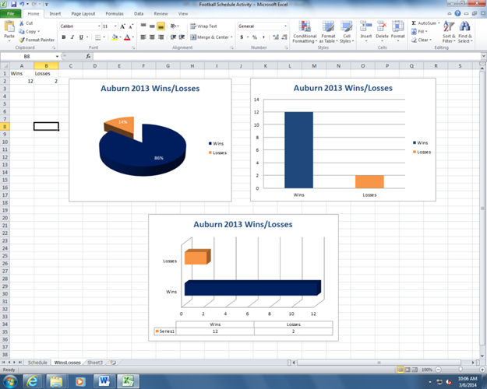
Unit 7 – Financial management
Standard FIN-IBT-8: Understand, interpret, and use accounting principles to make financial decisions.
Essential Question: How can a business owner use financial management to help guide their business?
Bell Ringer: What function adds all the numbers in a range of cells?
Today’s Assignment: Excel Football Schedule Activity – Part 2
**Reminder: CDA next Thursday, March 30th

Slide 12
Unit 7 – Financial management
Standard FIN-IBT-8: Understand, interpret, and use accounting principles to make financial decisions.
Essential Question: How can a business owner use financial management to help guide their business?
Bell Ringer: Unit 7 Bell Ringers due Wednesday, March 29th
Today’s Assignment: Complete missing Unit 7 assignments
**Reminder: CDA Thursday, March 30th

